Slide 1

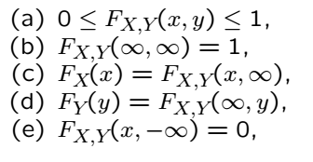
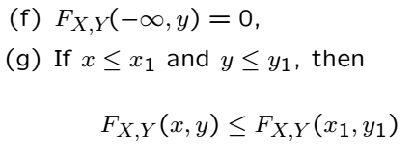
Joint Distributions: CDF
Applies to continuous or discrete
Can be extended to more than 2 RVs
CDF factors to product of marginals if RVs independent

Slide 2
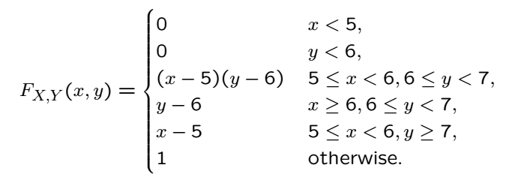

Example

Slide 3
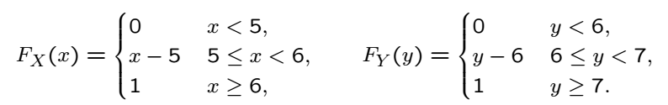
Solution
Both X and Y are uniformly distributed
Also, X and Y are independent!

Slide 4




Joint PMF
Convenient for discrete random variables
and are called marginal PMFs
A rectangular array of probabilities
Row-wise sum? Column-wise sum?

Slide 5
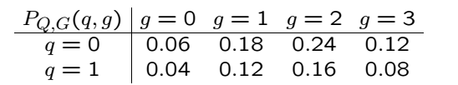
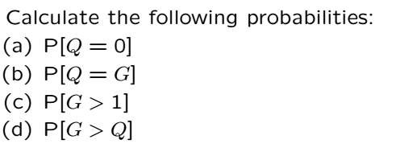
Example

Slide 6
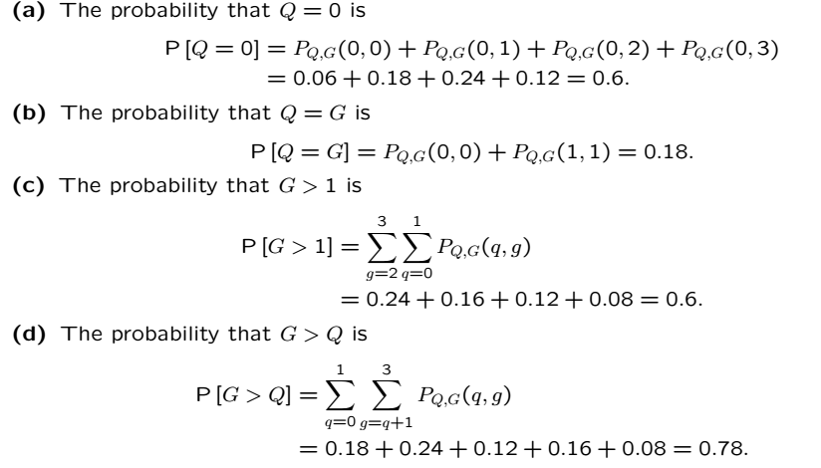
Solution

Slide 7
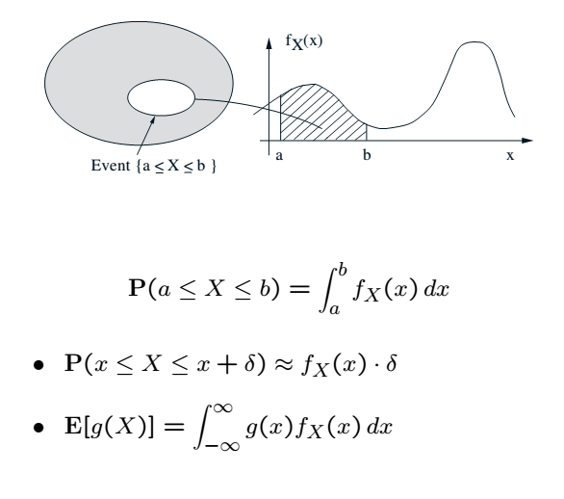
Recall

Slide 8




Joint PDF Definition

Slide 9
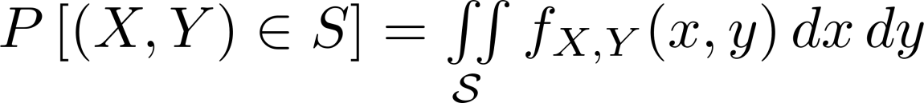
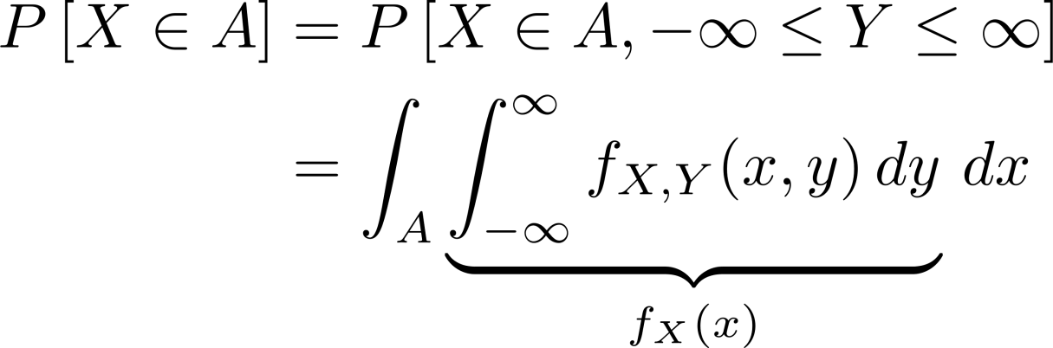
Joint PDF Interpretation
Interpretation:
From the joint to the marginal

Slide 10
Joint PDF Interpretation Cont’
Expectations
Independence
Follows from factorization of the CDF and

Slide 11
Acknowledgements and Citations
Parts of these slides are adapted from the following resources:
Power Point Lecture Slides for the Textbook http://bcs.wiley.com/hebcs/Books?action=index&bcsId=8676&itemId=1118324560
John Tsitsiklis. 6.041 Probabilistic Systems Analysis and Applied Probability, Fall 2010. (Massachusetts Institute of Technology: MIT OpenCourseWare),http://ocw.mit.edu (Accessed 13 Apr, 2015). License: Creative Commons BY-NC-SA

